Slide 1
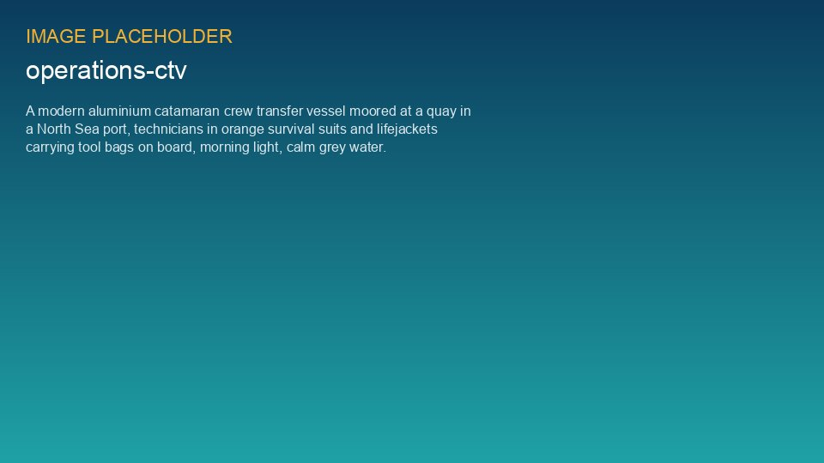
WEYLAND ENERGY
Harrow Bay O&M Readiness
Steering Committee · 24 September 2026

Slide 2
Status overview
8
6
2
4 / 32
Workstreams
On track
At risk
FTE today / at COD
WEYLAND ENERGY · Harrow Bay O&M Readiness – Steering Committee
2

Slide 3
Workstream status
Workstream | Status | Comment
O&M base Eastholm | At risk | Heads of terms agreed, lease drafting slower than planned
Organisation & recruitment | On track | Job profiles approved; first adverts Q1 2027
Vessels & marine coordination | On track | CTV tender launched 15 Sep
Control room integration | On track | SCADA read-only test link to HB-OSS working
Spare parts | On track | Capital spares list v1 done
HSE & ERP | On track | Offshore ERP draft with HSE
Contracts | At risk | Cable repair framework – only one bidder
Handover from project | On track | Handover criteria agreed with Elena
WEYLAND ENERGY · Harrow Bay O&M Readiness – Steering Committee
3

Slide 4
Construction interface
• 14 of 40 monopiles installed (2 Oct)
• Offshore substation topside installed 19 Aug
• HB-RISK-017: export cable 2 delay – no impact on O&M base dates
• First turbine installation planned 1 March 2027
WEYLAND ENERGY · Harrow Bay O&M Readiness – Steering Committee
4

Slide 5
Decisions needed
• Approve pre-COD readiness budget release 2027: EUR 2.4 m
• Approve recruitment start for marine coordinators in January 2027
• Mandate Legal to open a second bidder for the cable repair framework
WEYLAND ENERGY · Harrow Bay O&M Readiness – Steering Committee
5
Notes:
Ask Jonas beforehand about the budget release – he wants the phasing by quarter.

Slide 6
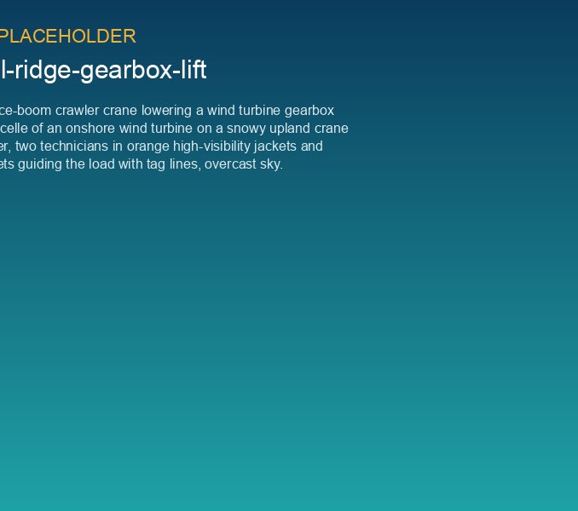
Lessons from Kestrel Ridge
• Own the CMS thresholds and data from day one
• Agree spare part pool access before COD
• Plan crane / jack-up access windows for major components
WEYLAND ENERGY · Harrow Bay O&M Readiness – Steering Committee
6

Slide 7
WEYLAND ENERGY
Next steps
Next steering committee: 10 December 2026

